Slide 1
New Spark solutions for distributed frequent itemset and association rule mining algorithms
(From Springer 2024)
MAHIZHA N S (21PW13) &
MEENA S (21PW14)

Slide 2
AGENDA
Problem statement
Abstract
Methodology
Dataset
Solution

Slide 3
PROBLEM STATEMENT
Data Explosion: The massive amount of data generated daily by companies, social networks, and IoT devices.
Challenges: High computational cost and memory limitations in processing large datasets using traditional data mining techniques.
Objective: Efficiently extract frequent itemsets and association rules from large datasets using distributed computing.

Slide 4
ABSTRACT
Purpose: To develop new efficient algorithms for frequent itemset mining and association rule mining using the Spark framework.
Goals:
Review existing algorithms for frequent itemset and association rule mining.
Develop new Big Data algorithms for frequent itemset mining and a new association rule mining algorithm in Spark.
Compare the proposed algorithms with existing ones in terms of speed, efficiency, and memory consumption.

Slide 5
DATASET
From https://archive.ics.uci. edu/ml/index.php and https://www.kaggle.com 1. Poker Dataset (Source: UCI Machine Learning Repository )
Each transaction represents a poker hand, and the goal is to find frequent combinations of cards.
2. Susy Dataset (Source: UCI Machine Learning Repository )
3. Higgs Dataset (Source: UCI Machine Learning Repository )
Each transaction represents a collision event, and the goal is to find frequent patterns in the attributes of these events.
4. Otto Dataset (Source: Kaggle)
Each transaction represents a product, and the goal is to find frequent combinations of product features. The datasets cover a range of applications from gaming (Poker) to scientific research (Susy and Higgs) and e-commerce (Otto).

Slide 6
METHODOLOGY
Framework: Utilized the Spark platform for its in-memory processing capabilities, which significantly improve computing speed.
Algorithms Developed:
DApriori: A distributed version of the Apriori algorithm.
DATID: A distributed version of the Apriori-TID algorithm.
DECLAT: A distributed version of the ECLAT algorithm.
Comparison: Compared the new algorithms with YAFIM and PFP algorithms available in the Spark library.
Evaluation Metrics: Speed, efficiency, memory consumption, and the number of association rules generated.

Slide 7
Sequential and parallel approaches
(review of existing algorithms)
Apriori-TID ->
to reduce itemset by sorting the transactions by item frequency,removing non-frequent ones in each step.
ECLAT->
improve computations using Boolean operators.
FP-growth employs an FP-tree structure for using the divide-and-conquer technique and consulting the database of transactions only once. This results in a very fast algorithm.
FP-Growth outperforms the others with respect to time consumption, but, Apriori and Apriori-TID need less resources in terms of memory.
parallel versions of Apriori->ParEclat (Parallel Eclat) and parallel FP growth with sampling.

Slide 8
Distributive approaches
Hadoop approaches
Dist-Eclat and BigFIM algorithm -> extraction of frequent itemsets.
Spark approaches ( Spark offers some advantages enabling faster memory operations than Hadoop since it allows in-memory computations)
Exhaustive approaches:
YAFIM, R-Apriori -> They make the loop to search k itemsets inside the distributed process using a hash tree, meanwhile we make the MapReduce for every k-itemset using a hash table.
Non-exhaustive approaches:
PFP which is a distributed adaptation of FP-Growth algorithm for mining most frequent itemsets.

Slide 9
Proposed solutions
Inspired on Apriori, Apriori-TID and ECLAT to discover frequent itemsets, and another new algorithm to extract association rules.
algorithms that are exhaustive with batch data processing, incorporating the PFP (Parallel FP-Growth) approach to compare with a non-exhaustive algorithm, and the YAFIM algorithm whose implementations in the Spark library.
Developed Algorithms: DApriori, DATID and DECLAT (where the first ‘‘D’’ stands for distributive) for frequent itemset mining, and proposes a distributive algorithm for Association Rule Mining.

Slide 10
Proposed solutions
BigData - MapReduce() - manages all data transfers and communications, provides redundancy, fault-tolerance and job scheduling.
Map() -> the processing of data and returns the data transformed into key value pairs.
Reduce() -> aggregates the lists of (key, value) pairs sharing the same key to obtain a piece of processed data (compute frequency)

Slide 11
Spark Solution
Spark allows in-memory computing, so complex algorithms can be developed.
Supports an advanced Directed Acyclic Graph (DAG) execution engine that enables cyclic data flow.
Data structure -> Resilient distributed dataset (RDD) - data collections are distributed across the clusters.
Some primitive spark functions:
Map: Applies a transformation function to each element of RDD and returns a transformed RDD.
FlatMap: Similar to Map, but each input item can be mapped to 0 or more output items.
Reduce: Aggregates the elements of the dataset using an aggregation function.
Broadcast variables which are the global variables.

Slide 12
DApriori: Apriori big data approach
First Phase: Item Frequency Calculation
The process begins by loading the dataset and determining the frequency of each item across transactions.
A FlatMap function is employed to ensure that each item in a transaction is processed individually. This is crucial for the subsequent Map function, which generates pairs in the format of item; 1 for each occurrence of an item in a transaction.
The Reduce phase then merges these pairs by their keys, filtering out items that do not meet the Minimum Support (MinSupp) threshold. This phase effectively identifies the frequent individual items in the dataset.
2) Second Phase: Candidate Itemset Generation
The frequent items identified in the first phase are used to generate candidate itemsets of greater length, leveraging the downward closure property of frequent itemsets.
Similar to the first phase, this stage also utilizes a FlatMap followed by a MapReduce process, along with a filtering step based on support. This process is repeated iteratively until no new candidates of higher length can be formed.
A global broadcast variable is utilized to store candidate items, ensuring they are accessible across all partitions in the cluster during processing.

Slide 13
2. DATID: Apriori-TID approach
The DATID algorithm is a distributed approach for mining frequent itemsets from large datasets using Apache Spark. It consists of two main phases: Frequency Item Calculation and Candidate Generation.
Phase 1: Frequency Item Calculation (FreqItems)
Input Data: The algorithm begins with a set of transactions represented as an RDD (Resilient Distributed Dataset) and a minimum support threshold.
Distributed Processing: The transactions are divided into q chunks for parallel processing.
Mapping and Reducing:
Each chunk is flattened to extract individual items.
A mapping step counts occurrences of each item.
A reducing step aggregates these counts to determine the support for each item.
Filtering: Items that meet or exceed the minimum support threshold are retained as frequent items.
Data Preparation: The remaining transactions are processed to remove the frequent items and sorted for further analysis.

Slide 14
2. DATID: Apriori-TID approach
Phase 2: Candidate Generation
Initialization: The algorithm starts with the frequent items as candidates of length 1.
Iterative Process:
The algorithm enters a loop that continues as long as there are frequent itemsets to process.
For each iteration, the transactions are again processed in chunks to count the support of itemsets.
Frequent itemsets are filtered based on the minimum support threshold.
Candidate Generation: New candidates of increasing length are generated from the current frequent itemsets.
Aggregation: The newly generated candidates are appended to the global list of frequent itemsets.
Output
The final output of the algorithm is a list of global frequent itemsets that exceed the specified minimum support threshold. This structured approach allows the DATID algorithm to efficiently handle large datasets by leveraging Spark's distributed computing capabilities, making it suitable for real-time data mining tasks.

Slide 15
3. DECLAT: ECLAT approach
1)Data Distribution and Preprocessing
Unlike other algorithms like DApriori, which distribute processes by transactions, DECLAT distributes data by itemsets. This necessitates a preprocessing phase where the database is transformed to treat items as transactions.
The preprocessing involves two main functions:
A FlatMap function that generates pairs in the format of TransactionID; Item for each item in a transaction.
A GroupByKey function that aggregates these pairs, resulting in pairs of Item; ListTransaction, where the list indicates the presence (1) or absence (0) of the item in each transaction.
2)Two Phases of the Algorithm
First Phase: After preprocessing, the algorithm counts the occurrences of each item in transactions. The Reduce function is then used to identify frequent items and generate candidate itemsets for the next phase.
Second Phase: The algorithm employs the FlatMap function again to create pairs of itemsets and their presence in transactions. The support for these itemsets is computed using the Reduce function, allowing for the identification of frequent itemsets.

Slide 16
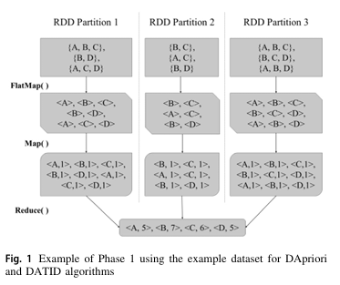

Slide 17
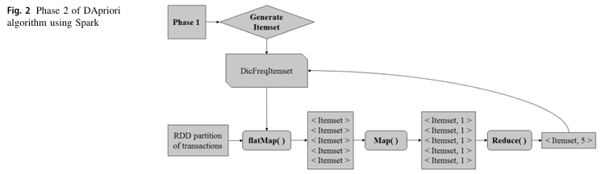

Slide 18
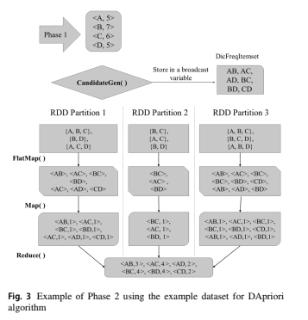

Slide 19
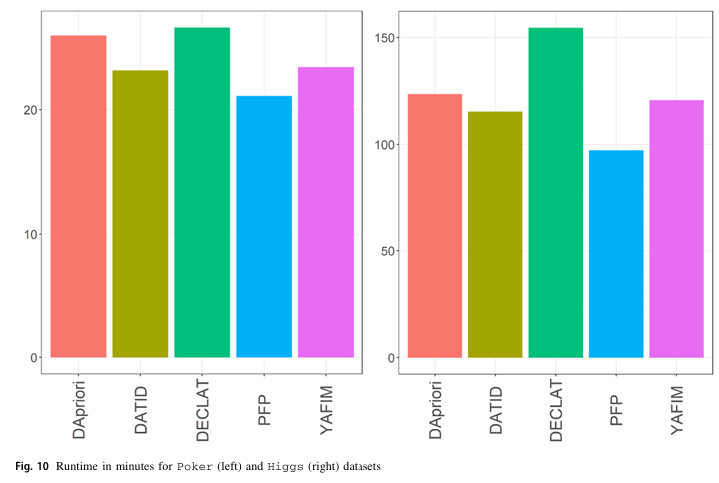

Slide 20
RESULT
Performance:
DApriori, DATID, DECLAT: Comparable runtime, with DATID showing better memory usage.
PFP: Fastest runtime but non-exhaustive, missing some association rules.
Scalability: All algorithms showed improved speed up and efficiency with increased cores, though not proportional due to network congestion.
Memory Usage: DATID outperformed others in most cases.
Association Rules: DApriori, DATID, DECLAT, and YAFIM generated all possible rules, while PFP missed some due to its non-exhaustive nature.
Conclusion
Best Algorithm: DATID for exhaustive frequent itemset mining and association rule generation.
Future Work: Improve PFP for complete frequent itemset extraction and develop algorithms for streaming data.

Slide 21
THANK YOU

